Slide 1

Why do patients miss nhs appointments?
By: Alexander Sewell

Slide 2
Background
Patients missing their booked appointments incurs significant costs to NHS.
To reduce missed appointments, we must better understand why patients miss appointments.
To achieve this, we must answer the following 2 questions:
Has there been adequate staff and capacity in the networks?
What was the actual utilisation of resources?
Target audience: NHS Board.
Recommendations on how to reduce missed appointments will then be provided.

Slide 3
Background continued
Additional sub-questions will also be answered:
Which service setting reported the most appointments in North-West London from 1 January to 1 June 2022?
Which month recorded the most appointments?
What monthly and seasonal trends are evident?
What are the top trending hashtags on Twitter related to healthcare in the UK?

Slide 4
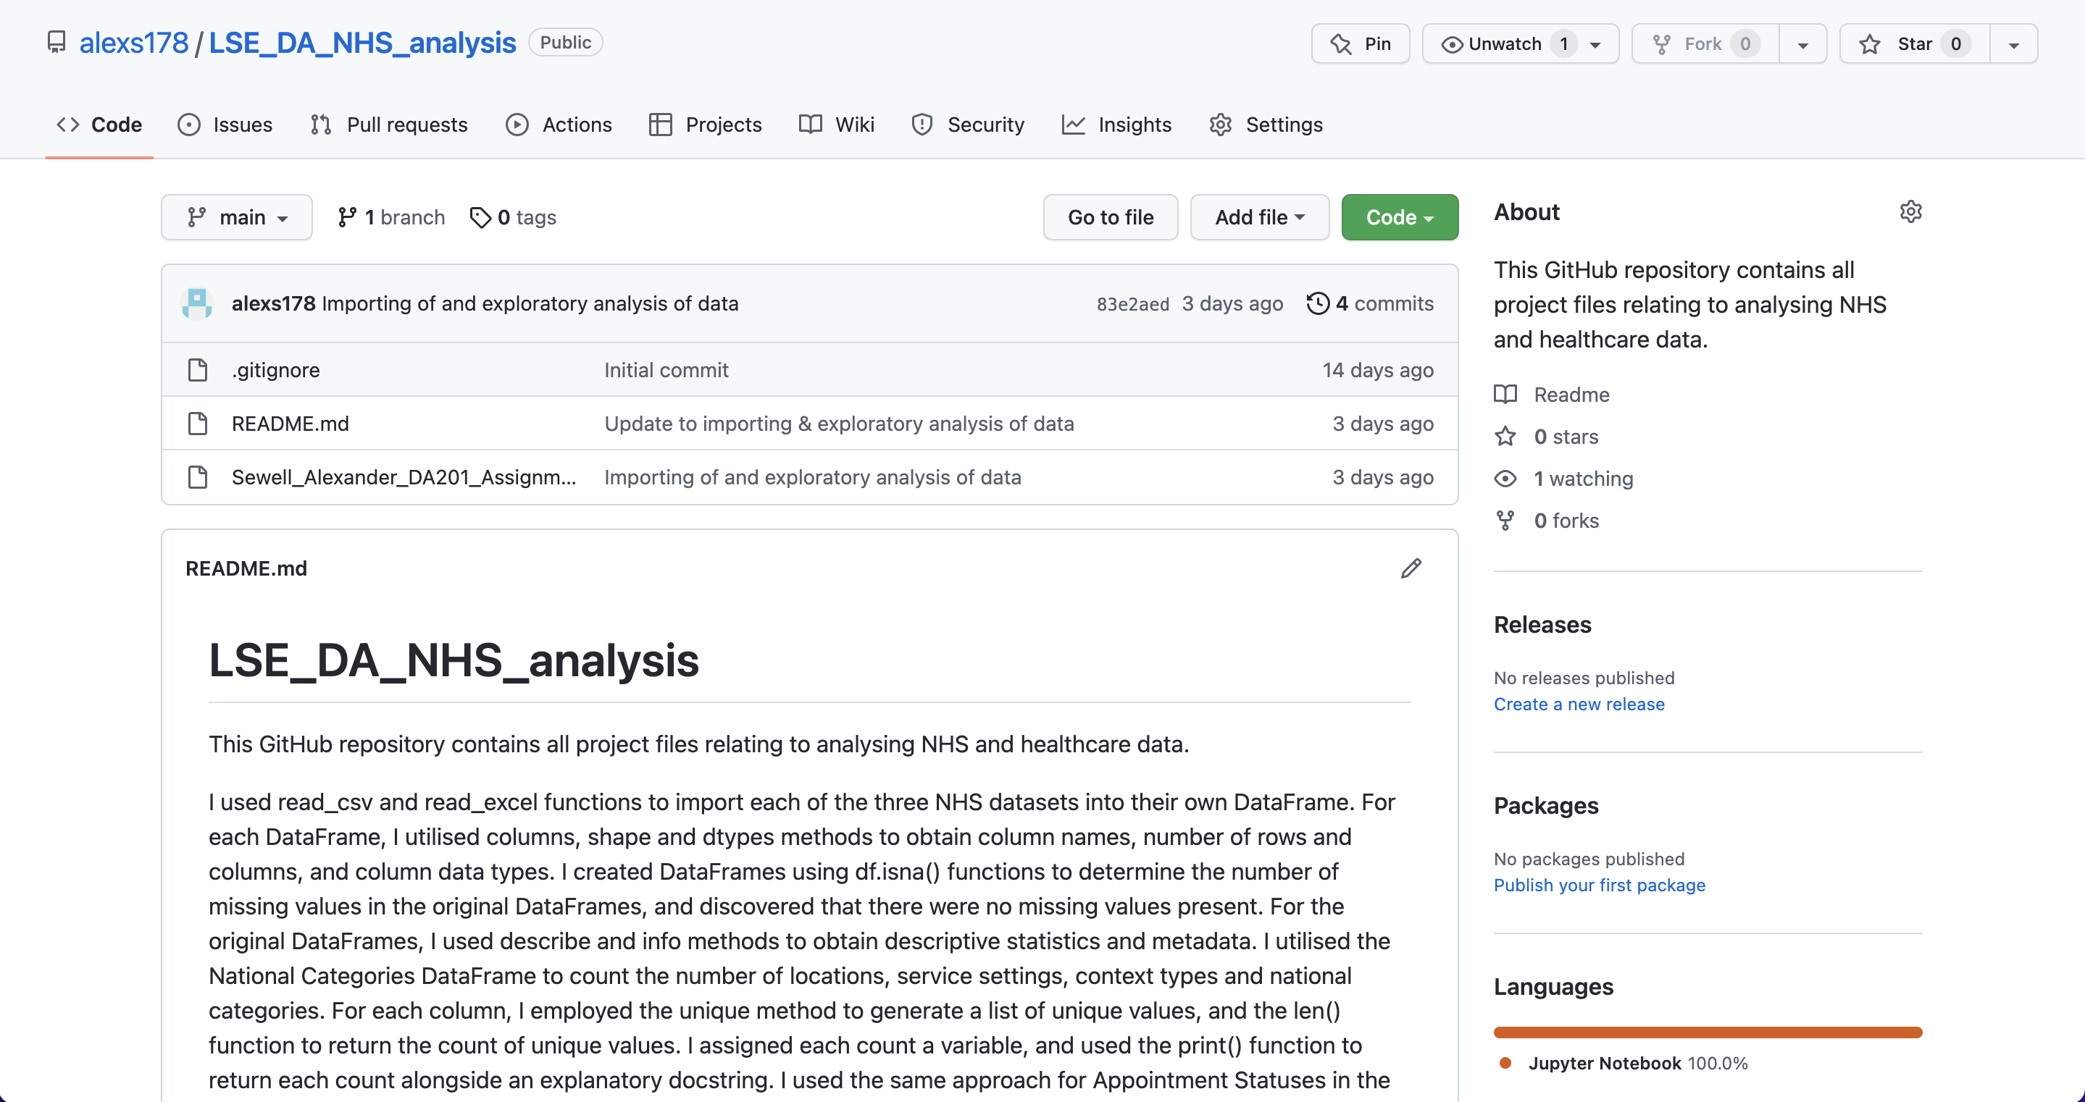
Additional context
This presentation is stored in a GitHub repository: https://github.com/alexs178/LSE_DA_NHS_analysis
Python language utilised as its extensive visualisation tools allow easy communication of data insights.
Lineplots used to effectively visualise changes in appointments over time, and derive actionable insights.
Presentation findings cover August 2021 – June 2022.

Slide 5
Patterns, trends and insights

Slide 6
Exploratory data analysis
Initially explored appointments in North-West London from 1 January – 1 June 2022:
GP appointments was clearly the most utilised service setting: c.4.8m GP appointments out of c.5.6m total appointments.
Suggests GP appointments are most utilised service setting by wide margin.
Calculating total appointments per month across all months and locations: November 2021 featured most appointments: c.30.4m appointments.
Suggests NHS demand is particularly high in Autumn.

Slide 7
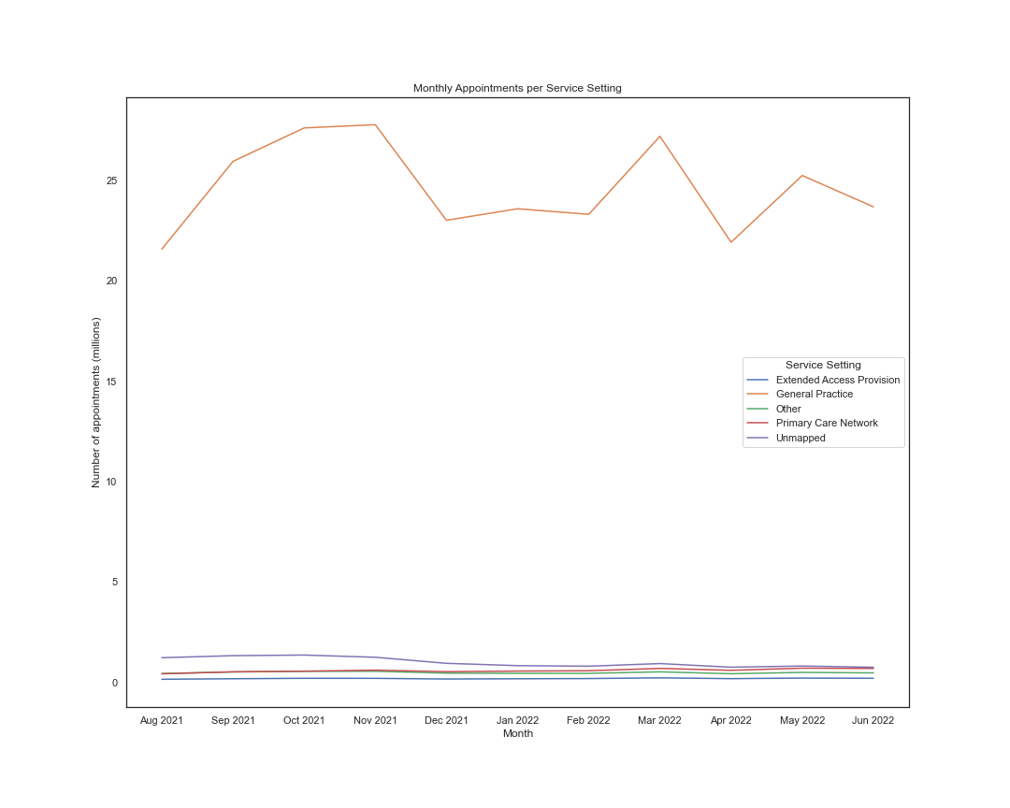
Monthly appointments per service setting

Slide 8
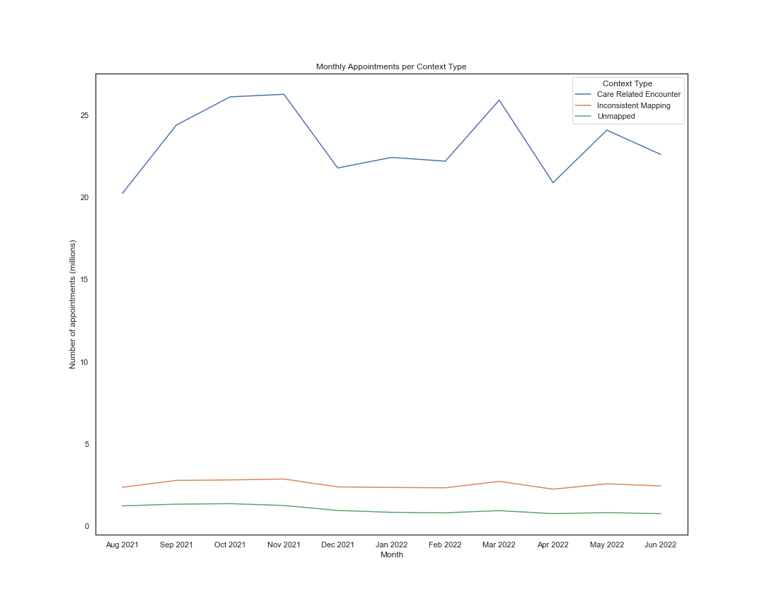
Monthly appointments per context type

Slide 9
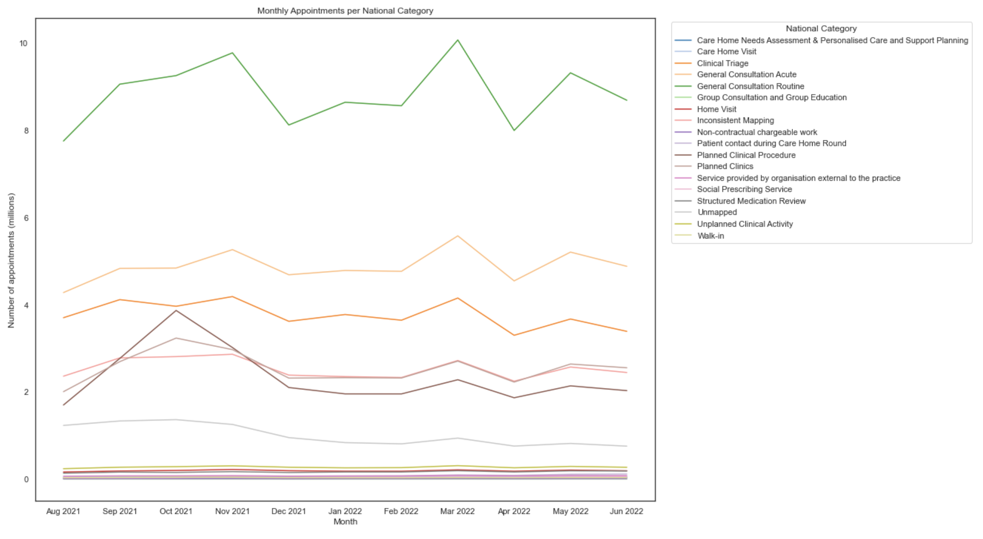
Monthly appointments per National category

Slide 10
Monthly trends
Demand for appointments is particularly strong in October, November & March.
Demand is relatively low in August & April.

Slide 11
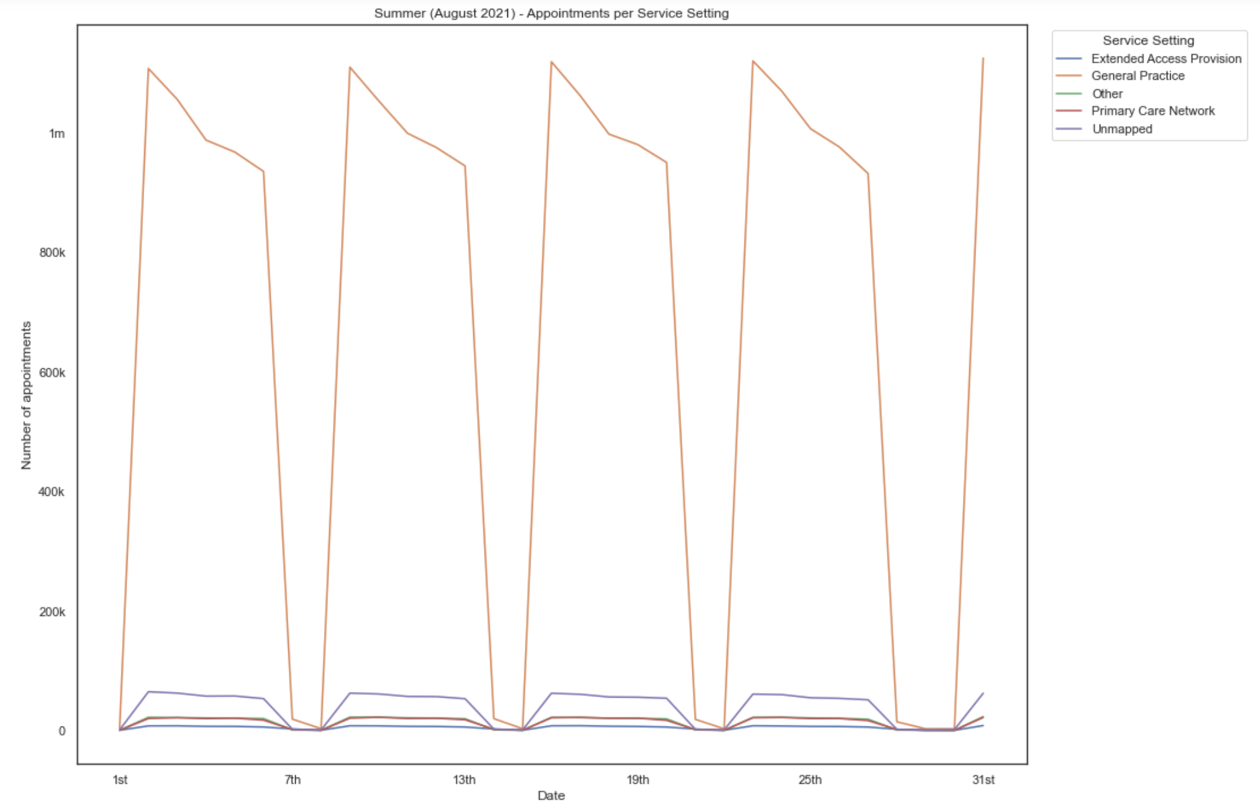
Daily appointments per service setting – summer
Weekdays
Weekends & bank holidays

Slide 12
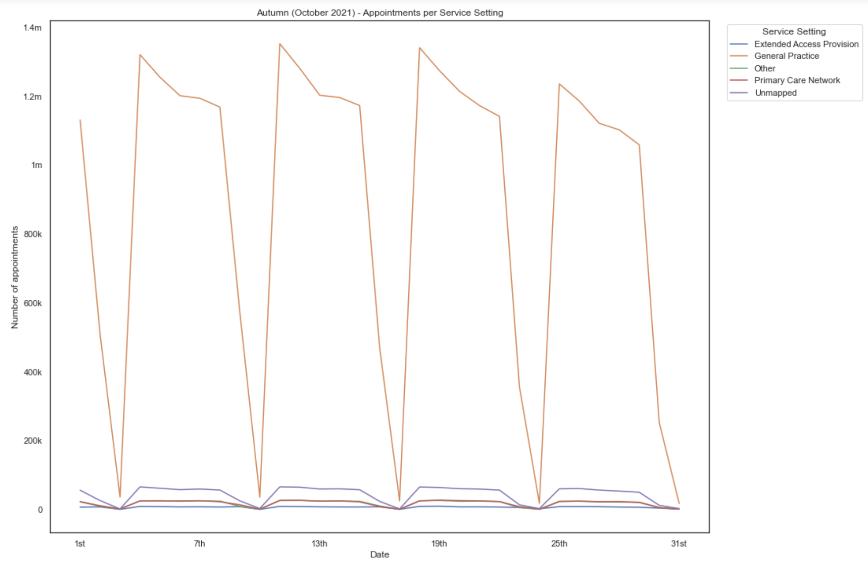
Daily appointments per service setting – Autumn
Amongst all 4 seasons: date with highest number of GP appointments
Saturday

Slide 13
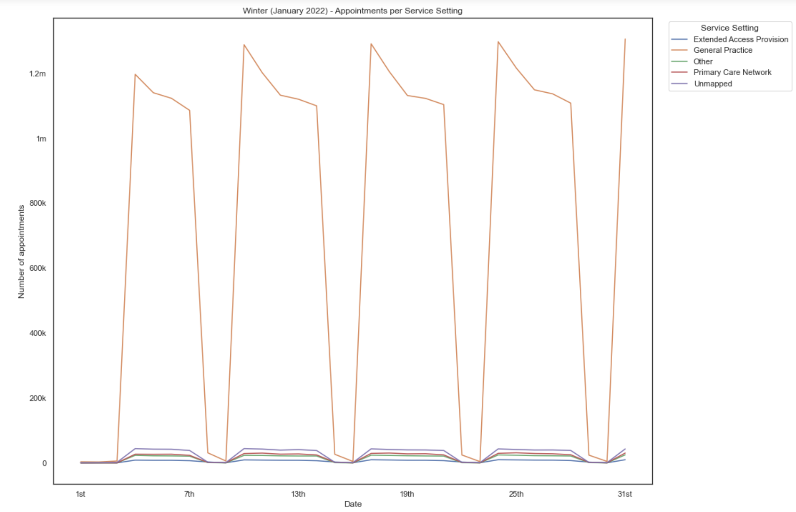
Daily appointments per service setting – winter

Slide 14
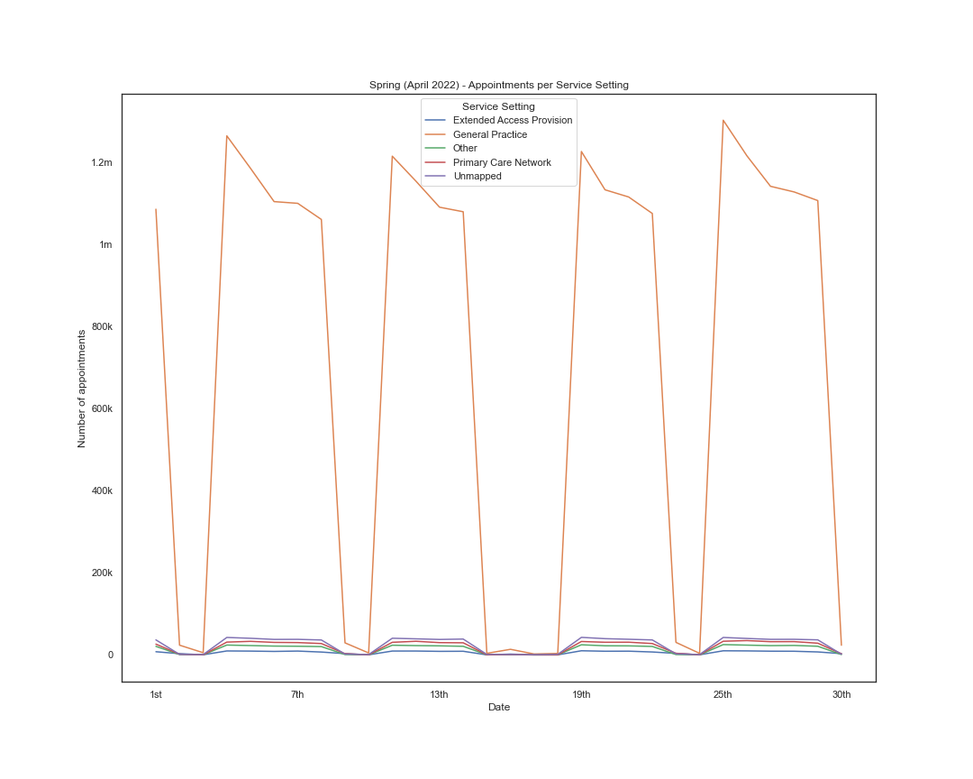
Daily appointments per service setting – spring
Easter Weekend

Slide 15
Seasonal trends
NHS demand is highest in early Autumn.
NHS demand is lowest in early Summer.

Slide 16
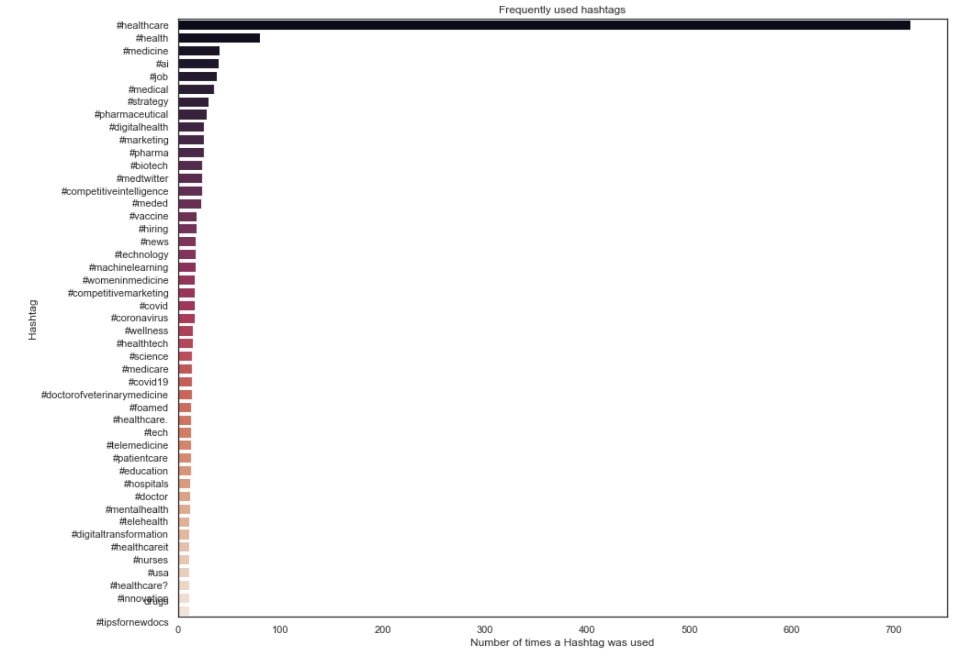
Twitter analysis

Slide 17
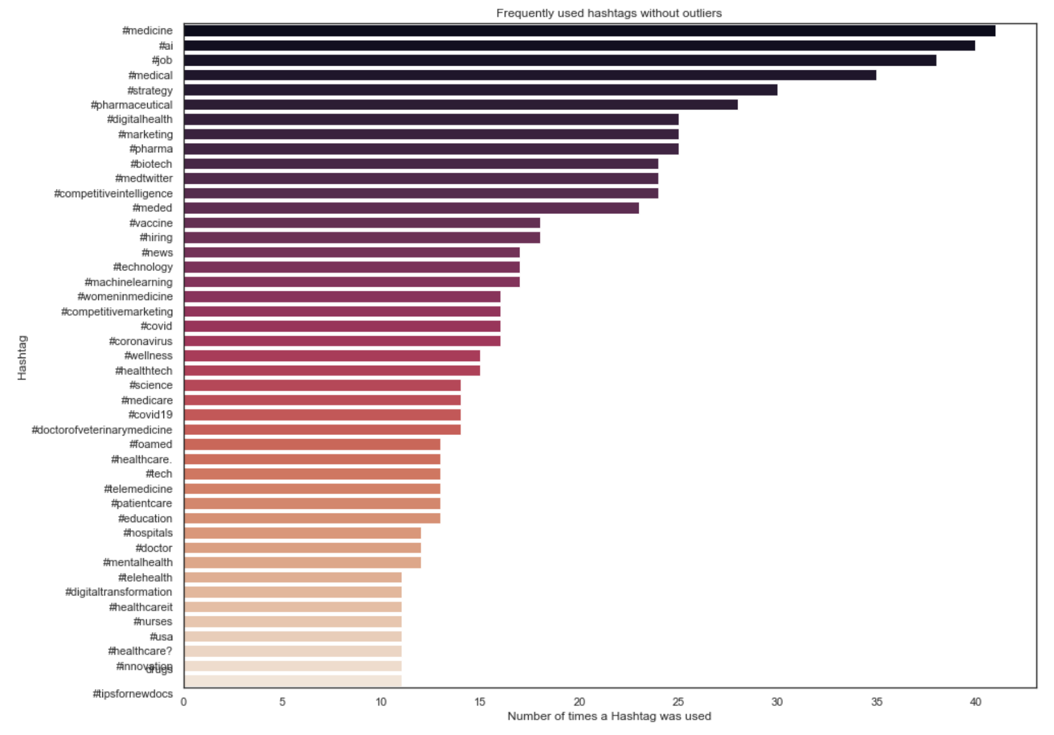
Twitter analysis continued

Slide 18
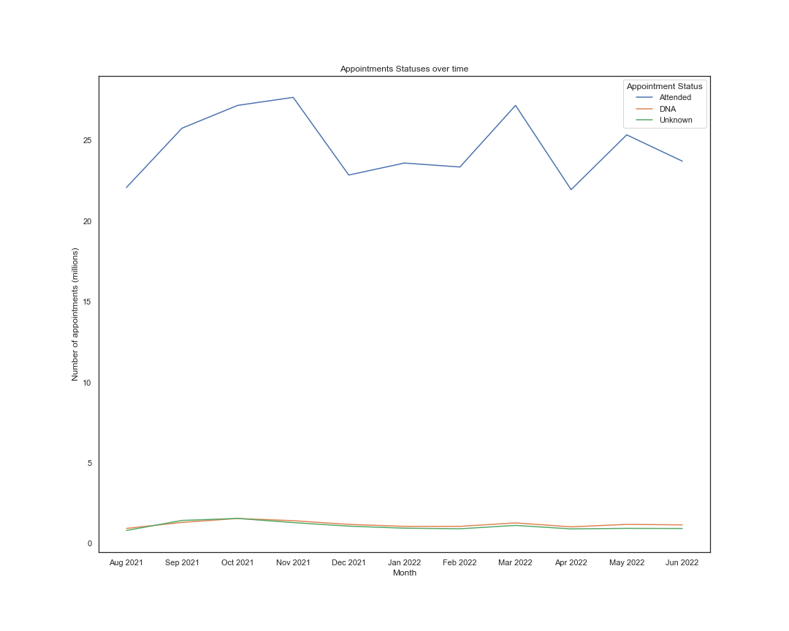
Missed appointments

Slide 19
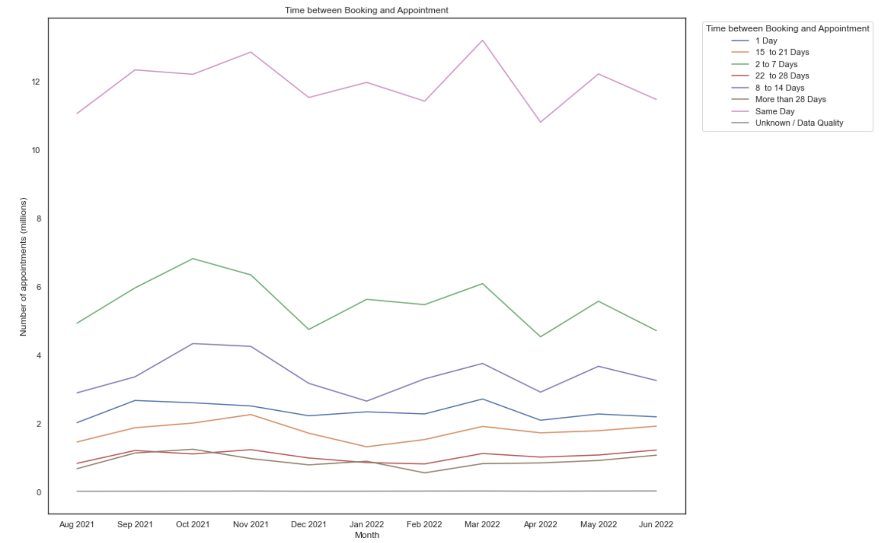
Appointment waiting times

Slide 20
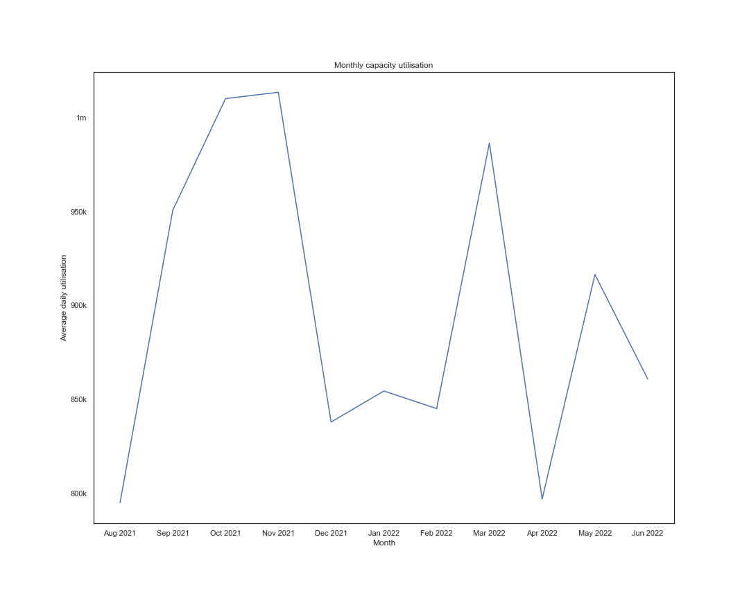
Nhs capacity

Slide 21
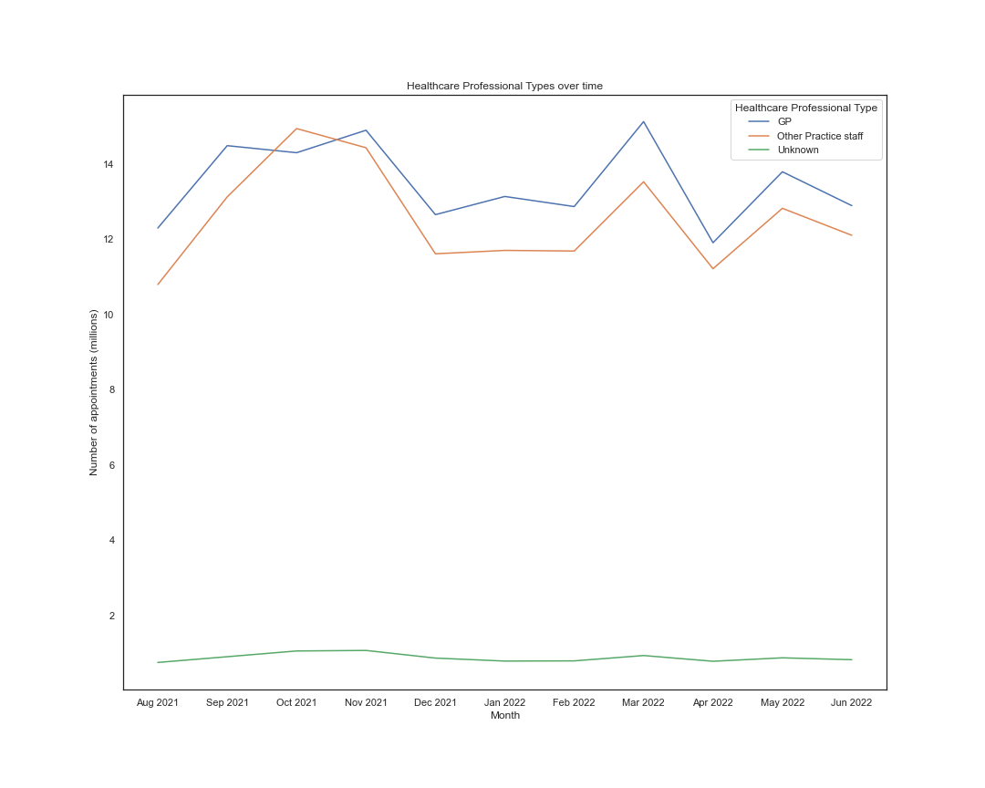
Utilisation of healthcare professional types

Slide 22
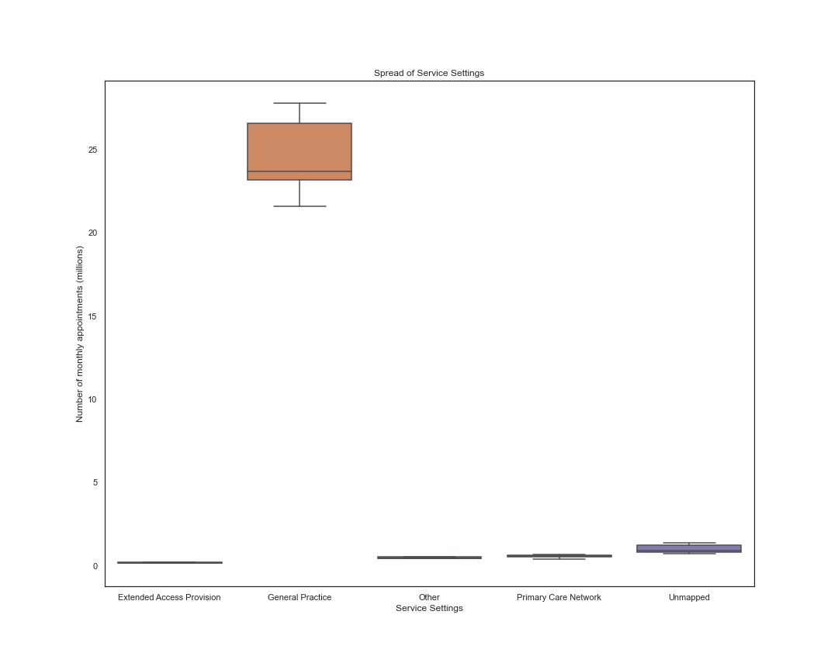
Utilisation of service settings

Slide 23
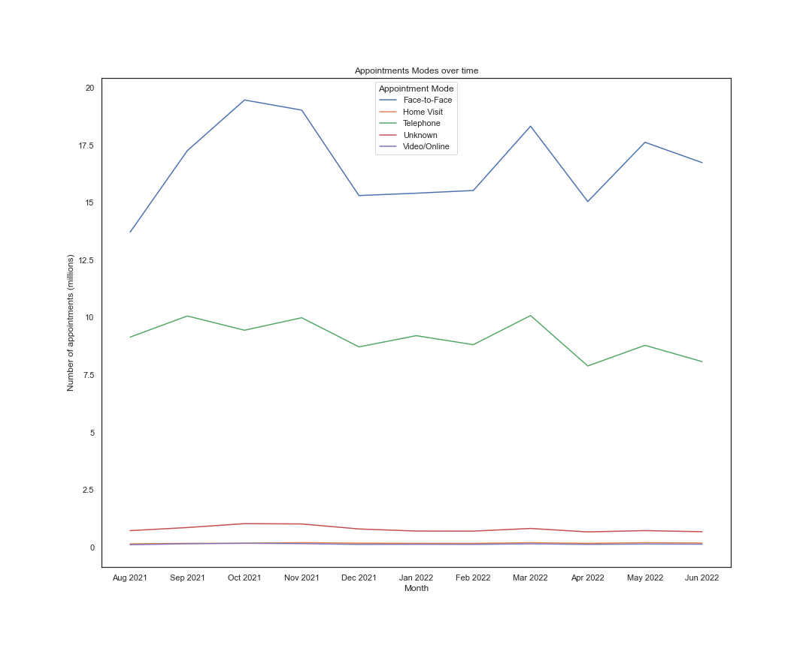
Utilisation of appointment modes

Slide 24
recommendations
Increase NHS staff.
In particular, hire more GPs.
GPs should commit to more telephone appointments.
For future analysis, survey patients who missed appointments on their reasons for doing so.

Slide 25
conclusion
Many months feature over 1m missed appointments.
This is a result of NHS understaffing.
Insufficient staff to meet demand for appointments leads to long waiting periods between bookings & appointments.
Patients’ issues may resolve themselves during long waiting periods, resulting in patients not attending their booked appointments.
To solve this issue, the NHS must hire more staff, more GPs, and increase telephone appointments with patients.

